Slide 1

Project 1
Seth Hanusik
US County Air Quality Visualizations

Slide 2
Data Overview
Used a short Python script to combine all individual year CSVs into one
For the line charts and the No Measurement bar chart, I pick the selected county data off the main CSV
For the last two bar charts, I pick the specific year and create a JSON object for each specific description and pollutant type
Data obtained from here: https://aqs.epa.gov/aqsweb/airdata/download_files.html#Annual

Slide 3
GUI
A sticky header at the top where the user can select their state, county, and year
Allows the user to see changes in whichever chart they choose
The user can hover over the AQI line chart to see a tooltip and they can click on the desired year to change the selected year
The user can hover over the description and pollutant bar charts to see the specific number of days

Slide 4
Charts
AQI
Shows the Max, 90th Percentile, and Median AQI over the years of the selected county
This chart can be interacted with, and the user can change the year by clicking
Pollutant Line
Shows the percentage of days that the pollutant was the dominant one for its given year
No Measurement
Each bar is a year showing the number of days that no measurement was recorded for that year
For years that contained no data, it will show 365 days of no recording
Description
Shows the number of days for the selected year that were categorized as their respective description
Pollutant
Shows the number of days for the selected year that were categorized as their respective pollutant

Slide 5
Discoveries
The application allows users to compare county air quality trends across the years 1980-2021
Overall, air quality in the US has declined in the last 40 years, according to AQI
Comparing counties in completely different regions (Hamilton, Ohio and Orange, California) they often follow similar trends in both AQI and pollutant percentage

Slide 6
Code
Main.js
Holds the data processing code, event handlers for changing the counties and year, and creates class instances for each SVG
SVG files
Each SVG has its own class which holds the all code needed to create, update, and interact with the visualization
Repo
https://github.com/Kisunah/visual-interfaces/tree/main/Project1
Running the project
Inside the project directory, start a simple python server and access it on Google Chrome at the localhost port you started the server on

Slide 7
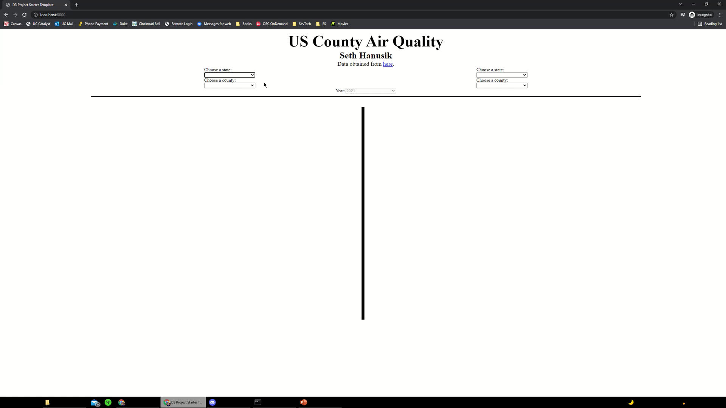
Demo

